Slide 1
CSC 3430: Algorithm Analysis and Design Final Exam Study Guide Example Exercises
By Chandler Stevens

Slide 2
Exercise 1: The Dijkstra Run (Problem)
Given the weighted, directed graph on the next slide:
Find the shortest path from vertex "Kessel" to vertex "Oba Diah" using Dijkstra's algorithm.
Weights provided are given in parsecs, a unit used to measure astronomical distances.
Labels are provided at each vertex for better convenience while running Dijkstra's algorithm.

Slide 3
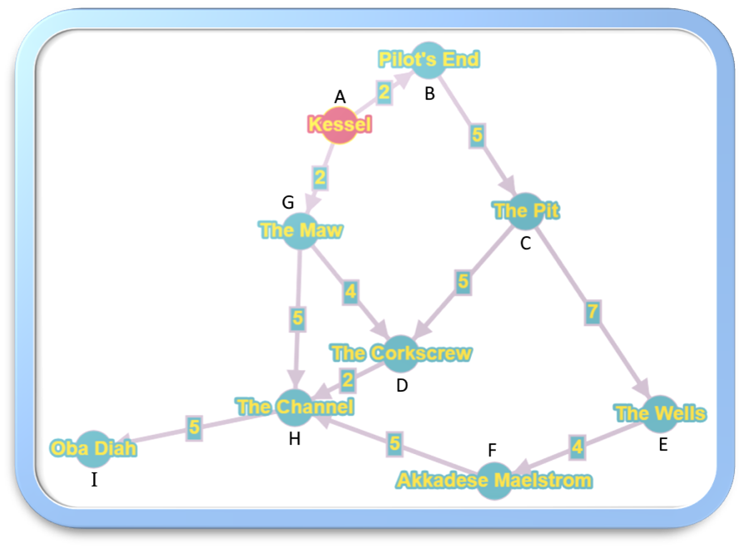
Exercise 1: The Dijkstra Run (Graph)

Slide 4
Exercise 1: The Dijkstra Run (Solution)
Han Solo's record-breaking flight through the Kessel Run followed this route:
Kessel (A) -> 2 -> The Maw (G) -> 5 -> The Channel (H) -> 5 -> Oba Diah (I)
This path resulted in a total travel distance of about 12 parsecs.

Slide 5
Exercise 1: The Dijkstra Run (Steps)
S | V - S | u | v | D[v] | D[u] + G.w(u, v) | D[B] | D[C] | D[D] | D[E] | D[F] | D[G] | D[H] | D[I]
A | B, C, D, E, F, G, H, I | B | C | ∞ | 2 + 5 = 7 | 2 | ∞ | ∞ | ∞ | ∞ | 2 | ∞ | ∞
A, B | C, D, E, F, G, H, I | G | D | ∞ | 2 + 4 = 6 | 2 | 7 | ∞ | ∞ | ∞ | 2 | ∞ | ∞
A, B, G | C, D, E, F, H, I | G | H | ∞ | 2 + 5 = 7 | 2 | 7 | 6 | ∞ | ∞ | 2 | ∞ | ∞
A, B, G | D, C, E, F, H, I | D | H | 7 | 6 + 2 = 8 | 2 | 7 | 6 | ∞ | ∞ | 2 | 7 | ∞
A, B, G, D | C, E, F, H, I | C | D | 6 | 7 + 5 = 12 | 2 | 7 | 6 | ∞ | ∞ | 2 | 7 | ∞
A, B, G, D, C | E, F, H, I | C | E | ∞ | 7 + 7 = 14 | 2 | 7 | 6 | ∞ | ∞ | 2 | 7 | ∞
A, B, G, D, C | E, F, H, I | H | I | ∞ | 7 + 5 = 12 | 2 | 7 | 6 | 14 | ∞ | 2 | 7 | ∞
A, B, G, D, C, H | E, F, I | I |  |  |  | 2 | 7 | 6 | 14 | ∞ | 2 | 7 | 12
A, B, G, D, C, H, I | E, F | E | F | ∞ | 14 + 4 = 18 | 2 | 7 | 6 | 14 | ∞ | 2 | 7 | 12
A, B, G, D, C, H, I, E | F | F | H | 7 | 18 + 5 = 23 | 2 | 7 | 6 | 14 | 18 | 2 | 7 | 12
A, B, G, D, C, H, I, E, F |  |  |  |  |  | 2 | 7 | 6 | 14 | 18 | 2 | 7 | 12

Slide 6
Exercise 2: Minimally Span Where No Tree Has Spanned Before (Problem)
Given the weighted, undirected graph on the next slide:
Find the Minimum Spanning Tree using Kruskal's algorithm.
Weights provided are given in light-years, a unit used to measure astronomical distances.
Graph is not to scale.

Slide 7
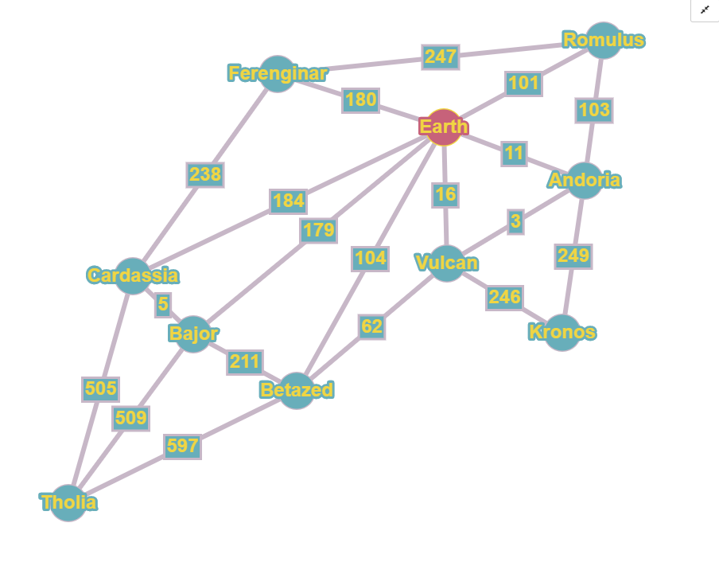
Exercise 2: Minimally Span Where No Tree Has Spanned Before (Graph)

Slide 8
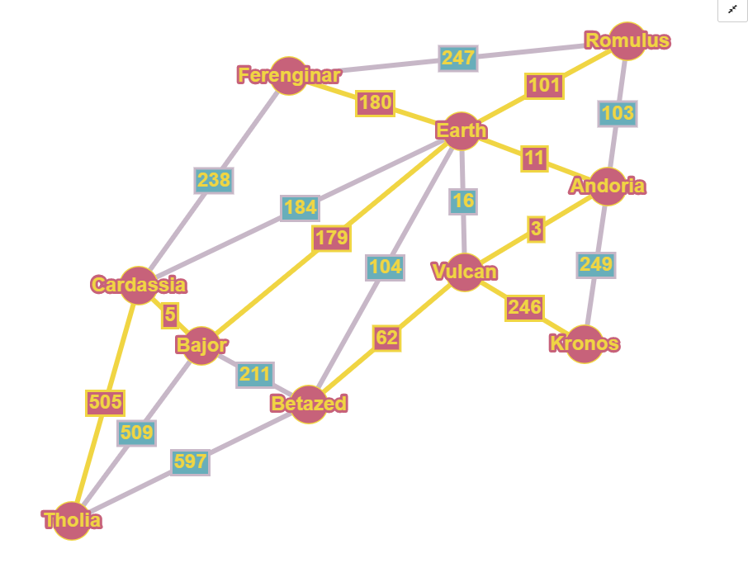
Exercise 2: Minimally Span Where No Tree Has Spanned Before (Solution)
The Minimum Spanning Tree has a total weight of 1,292 light-years.

Slide 9
Exercise 2: Minimally Span Where No Tree Has Spanned Before (Steps)
Vulcan Andoria 3 | Bajor Cardassia 5 | Earth Andoria 11 | Earth Vulcan 16
Vulcan Betazed 62 | Earth Romulus 101 | Andoria Romulus 103 | Earth Betazed 104
Earth Bajor 179 | Earth Ferenginar 180 | Earth Cardassia 184 | Bajor Betazed 211
Ferenginar Cardassia 238 | Vulcan Kronos 246 | Ferenginar Romulus 247 | Andoria Kronos 249
Tholia Cardassia 505 | Bajor Tholia 509 | Betazed Tholia 597

Slide 10
Exercise 3: One Does Not Simply Traverse A Graph (Problem)
Given the unweighted, undirected graph on the next slide:
Find the BFS tree/forest and the DFS tree/forest both starting from vertex "The Shire."

Slide 11
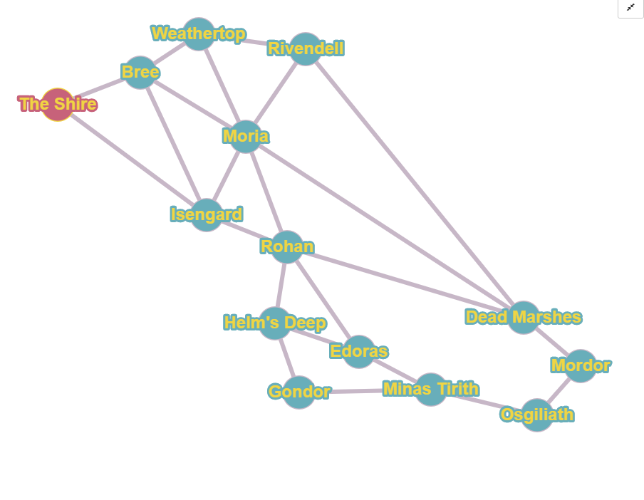
Exercise 3: One Does Not Simply Traverse A Graph (Graph)

Slide 12
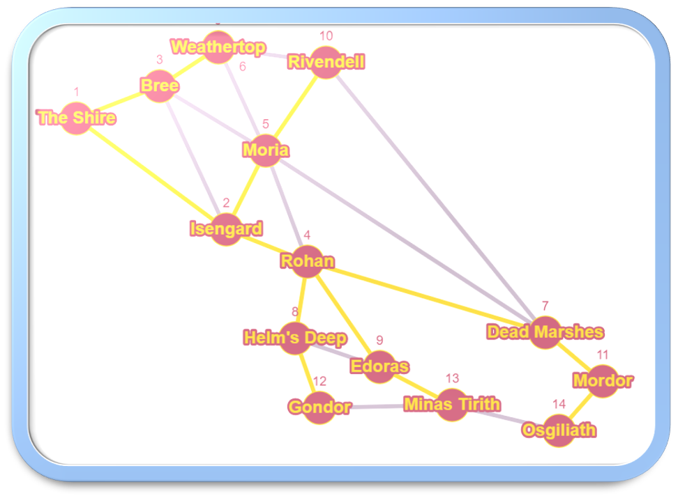
Exercise 3: One Does Not Simply Traverse A Graph (BFS Solution)

Slide 13
Exercise 3: One Does Not Simply Traverse A Graph (BFS Steps)
The Shire -> (Isengard and Bree)
Isengard -> (Rohan and Moria)
Bree -> (Weathertop)
Rohan -> (Dead Marshes, Helm’s Deep, and Edoras)
Moria -> (Rivendell)
Dead Marshes -> (Mordor)
Helm’s Deep -> (Gondor)
Edoras -> (Minas Tirith)
Mordor -> (Osgiliath)

Slide 14
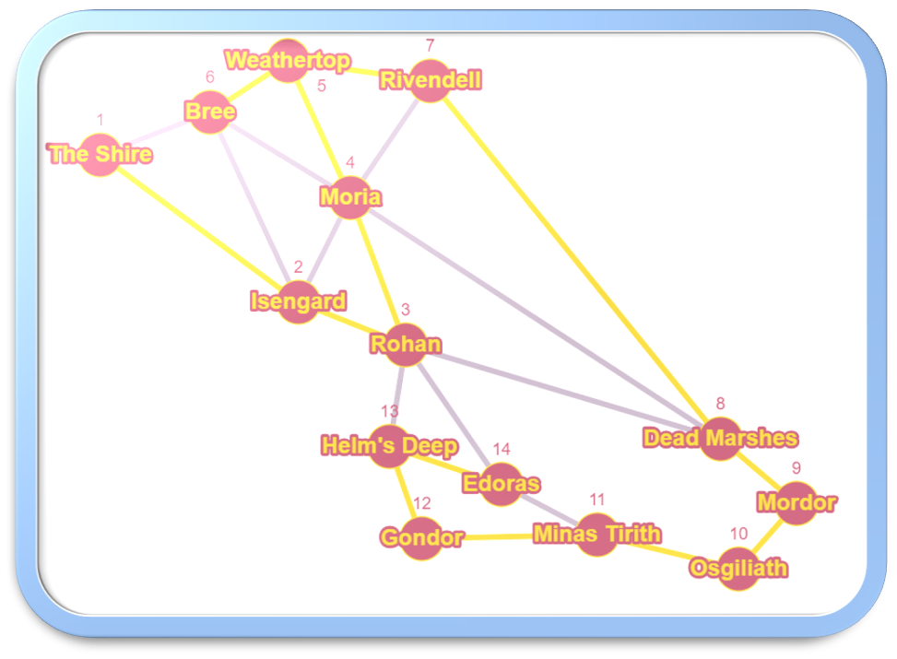
Exercise 3: One Does Not Simply Traverse A Graph (DFS Solution)

Slide 15
Exercise 3: One Does Not Simply Traverse A Graph (DFS Steps)
The Shire -> Isengard -> Rohan -> Moria -> Weathertop
Weathertop -> Bree
Weathertop -> Rivendell -> Dead Marshes -> Mordor -> Osgiliath -> Minas Tirith -> Gondor -> Helm’s Deep -> Edoras

